Slide 1
DEPARTMENT OF COMPUTER SCIENCE
GEOGRAPHICAL INFORMATION SYSTEM (GIS)
SCS3204
INTRODUCTION TO GIS
BY
Dr. Fredrick Kanobe (Ph.D)
Tel contact: 0782-592120 Emails: fkanobe@kyu.ac.ug or fred.Kanobe@gmail.com

Slide 2
Course Description
This course is to provide both a solid theoretical understanding and a comprehensive practical introduction to the use of geographic information systems, GIS-related terminologies and spatial data basics for the analysis and solution of different environmental problems. It introduces common image processing software packages and how to use them,
Course Outcome
By the end of the course, you should be able to:
Demonstrate an understanding of the GIS
Show knowledge of the basic principles underlying the GIS/model-based management systems
Demonstrate skills in GIS problem-solving techniques for sustainable planning and management
Input data in a GIS software tool
Design, create, maintain, and data integrate in a GIS software

Slide 3
REFERENCES:
Mich Paul Bolstad . (2016). GIS Fundamentals: A First Text on Geographic Information Systems, 5th edition. Eider Press
Michael N. DeMers. (2009). GIS For Dummies. For Dummies; 1 edition. ISBN-10: 0470236825,
ISBN-13: 978-0470236826
Paul A. Longley, Mike Goodchild, David J. Maguire, David W. Rhind . (2010). Geographic Information Systems and Science. Wiley; 3 edition. ISBN-10: 0470721448, ISBN-13: 978-0470721445
Law, Amy Collins. (2013). Getting to Know ArcGIS for Desktop. Esri Press; Third Edition .
Tim Ormsby, Eileen J. Napoleon, Robert Burke, Carolyn Groessl. (2010). Getting to Know ArcGIS Desktop. Esri Press; Second Edition, for ArcGIS 10 edition. ISBN-10: 1589482603,
Keith, C. Clarke.(2010). Getting Started with Geographic Information Systems (5th Edition). Prentice Hall; 5 edition. ISBN-10: 0131494988, ISBN-13: 978-0131494985
Indy Hurt, Keith C. Clarke. (2010). GIS Exercise Workbook for Getting Started with Geographic Information Systems. Prentice Hall; 5 edition. ISBN-10: 0321697960, ISBN-13: 978-0321697967

Slide 4
GEOGRAPHICAL INFORMATION SYSTEM (GIS)
A system that creates, manages, analyses and maps of all types of data. GIS connects all types of data to a map with all descriptive information hence providing a foundation for mapping and analysis that is used in science and almost all types of industry. GIS help users to understand patterns, relationships and geographical relationships in data.
A GIS can be viewed as a computer-based system used in the collection, maintenance, storage, analysis, output, and distribution of spatial data and information. It quantifies these locations by recording their coordinates, numbers that describe the position of these features on earth.
A geographic information system (GIS) is a computer system for capturing, storing, checking, and displaying data related to positions on Earth’s surface
Spatial data is any type of data that directly or indirectly references a specific geographical area or location. Sometimes called geospatial data or geographic information, spatial data can also numerically represent a physical object in a geographic coordinate system.

Slide 5
COMPONENTS OF GIS
GIS applications include both hardware (GIS devices) and software systems. These software applications may include cartographic data, photographic data, digital data, or data in spreadsheets.
Devices used in GIS
GIS data collection devices include the following:
Digitizers: Hardware device that receives analog information, such as sound or light, and records it digitally. Usually, the information is stored in a file on a computing device. GIS professionals can use digitizers to easily capture, store, analyze, and manage data while in the field. Examples of digitizers are digital cameras, tablets, scanners.
GPS Units: Any device used to receive information from GPS satellites and calculating your geographical position. The Geographical Positioning Unit (GPS) was originally developed by US government for military use but now any one can use GPD device. Commonly used in surveying and mapping.
Mobile devices: Various mobile devices with professional GIS features are used as GPS hardware used in data collection

Slide 6
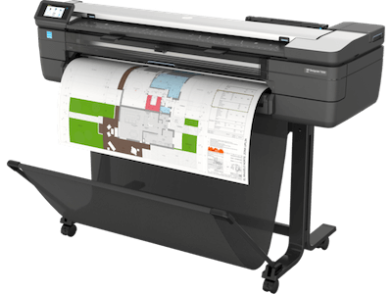
Devices used in GIS
Desktop Computer - You’ll need a large-display monitor, lots of RAM (more than 4 GB recommended), and plenty of extra space on the hard drive where you can upload your data for later use
Printer – Incredibly useful because they allow you to bring your digital map into the physical world. Once you print a map you can hang it on the office wall, distribute to your teams, or simply keep as reference
Key features for your GIS desktop computer

Slide 7
Categories of Data used in GIS
Cartographic data
Data already in map form, and may include such information as the location of rivers, roads, hills, and valleys. Cartographic data may also include survey data and mapping information that can be directly entered into a GIS.
Photographic data
Photographic interpretation is a major part of GIS. Photo interpretation involves analyzing aerial photographs and assessing the features that appear.
Digital data
Digital data can also be entered into GIS. An example of this kind of information is computer data collected by satellites that show land use—the location of farms, towns, and forests.
Spreadsheet
GIS can also include data in table or spreadsheet form, such as population demographics. Demographics can range from age, income, and ethnicity.

Slide 8
GIS Software Applications
GIS software provides the tools to manage, analyze, and effectively display and disseminate spatial information. We need tools to view and edit these data, manipulate them to generate and extract the information we require, and produce the materials to communicate the information we have developed.
Main functions of GIS software include:
(1) Data Entry (3)Data Management (5) Output
- Manual data capture - Documentation - hardcopy Printing
- Digital data capture - Compression - Graphic design
- Data import - Summarizing - Map design
- copy, emerge - Export format generation
(2) Editing (4) Analysis
- Feature editing - Attribute query
- Automated error detection - Spatial query
- Attribute editing - buffering
- terrain analysis

Slide 9
Common GIS applications
ArcGIS – the most common software suite in the GIS family. It is not open source though therefore, important to get licensed version in order to enjoy all its functions. ArcGIS was developed by Environmental Systems Research Institute (ESRI) Avoid software piracy. It supports multiple data formats, many data types and structures, and literally thousands of possible operations that may be applied to spatial data.
QGIS - Is an open-source software project, an initiative under the Open Source Geospatial Foundation. The software is a collaborative effort by a community of developers and users. QGIS is free, stable, changes smoothly through time, with the source code available so that it can be extended as needed for specific tasks.
GeoMedia - originally developed and supported by Intergraph, Incorporated. GeoMedia offers a complete set of data entry, analysis, and output tools. A comprehensive set of editing tools may be purchased,
including those for automated data entry and error detection, data development, data fusion, complex analyses, and sophisticated data display and map composition
MapInfo - MapInfo is a comprehensive set of GIS products developed by the MapInfo Corporation. Map-
Info products are used mainly in GIS business and municipal applications.

Slide 10
Common GIS applications Cont…
Idrisi - Idrisi is a GIS system developed by the Graduate School of Geography of Clark University. I t provides both image processing and GIS functions. Idrisi has been developed and maintained at an educational and research institution, and was initially used primarily as a teaching and research tool.
Manifold - Manifold is a relatively inexpensive GIS package with a surprising number of capabilities. Manifold combines GIS and some remote sensing capabilities. Basic spatial data entry and editing support are provided, as well as projections and raster analysis, image display and editing, and output. Manifold GIS providing sophisticated image editing capabilities in a spatially referenced framework.
Maptitude - Maptitude is a GIS product focused primarily on spatial analysis in a business environment. Tools support market identification through the integration of income, demographic, and sales data, allocation and store location through transportation analysis, and logistics planning.
AUTOCAD MAP 3D - AUTOCAD is the world’s largest-selling computer drafting and design package. Produced by Autodesk, Inc. It supports of engineering disciplines including surveying and civil engineering.

Slide 11
Common GIS applications Cont…
GRASS - Geographic Resource Analysis Support System, is a free, open source GIS that runs on many platform and originally developed by the U.S. Army Construction Engineering Laboratory (CERL). It commonly used in research.
MicroImages - MicroImages produces and supports a range of products, including software to edit and view spatial data, software to create digital atlases, and software to publish and serve data on the internet.
ERDAS (Earth Resources Data Analysis System) – Was originally developed as an image processing system. The original purpose of the software was to enter and analyze satellite image data. It can be used in commercial spatial data analysis.
Bentley Map - Bentley Systems has developed spatial analysis software for mobile device through enterprise levels, with a strong focus on flexible, integrated infrastructure design and development. Bentley has evolved into a general set of tools, including field data collection, photography, map composition, database management, analysis, and reporting.

Slide 12
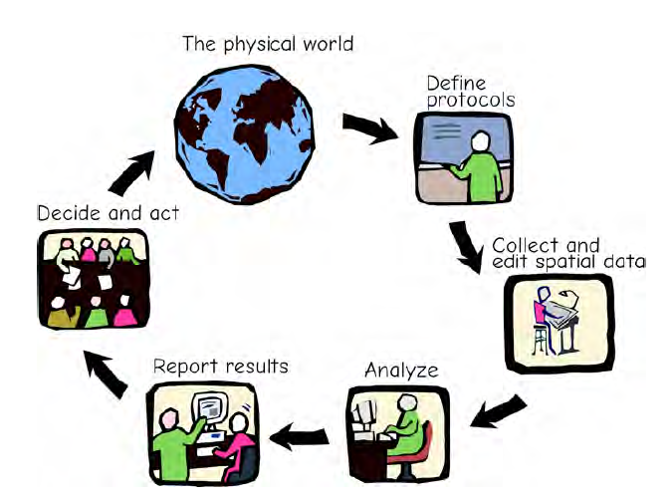
Common GIS applications Cont…
Smallworld - Smallworld, currently owned by General Electric Energy, is a product suite focused primarily on power and other utility management, and other network systems. Primarily targeted for large organizations,
the suite supports common spatial data formats, field data entry, complex, topological
network models, integration with corporate databases, component and network design.
GIS management Cycle

Slide 13
IMPORTANCE OF GIS IN REAL LIFE SITUATIONS
A GIS is also particularly useful at displaying spatial data and reporting the results of spatial analysis. GIS technology can be used compare the locations of different things in order to discover how they relate to each other. For example, using GIS, a single map could include sites that produce pollution, such as factories, and sites that are sensitive to pollution, such as wetlands and rivers.
GIS is essential tool in government and security organisations. It is a powerful tool used in fighting crime. Using GIS technology, security experts can easily trace thieves in their hiding locations
GIS regularly help in the day-to-day management of many natural and man-made resources, including sewerage, water, power, and transportation networks.
GIS allow us to analyze the relative spatial location of important geographic features. Spatial analyses in a GIS may aid in ensuring sustainable recreation, environmental protection, and other benefits
GIS help us identify and address environmental problems by providing crucial information on where problems occur and who are affected by them. GIS help us identify the source, location, and extent of adverse environmental impacts, and may help us devise practical plans for monitoring, managing, and mitigating environmental damage.

Slide 14
GIS can be used in the location of viable remnant plant and animal populations relative to current and future human land uses . Analysis of such information is helpful in planning for continued survival of such species.
GIS of recently has become an important tool used emergency services, flood protection, disaster assessment and management. It can be helpful in the location and identification disaster victims. The GIS matches the address to the nearest emergency service station, a route is then immediately generated based on the street network and traffic, and emergency crews dispatched from the nearest station. It can also be used to land mark disaster incidents and threats that form early warning systems in disaster management.
GIS hospitals and government transport functions. For example emergency vehicles such as ambulances in developed world commonly dispatched and routed using GIS.
GIS may be used to document change, mitigate damage, and effectively manage our natural resources. For example GIS images can be used to track eruptions of mountains and such data cab be used in planning evacuation of affected people and mapping of the damages caused.
Many businesses adopt GIS for increased efficiency in the delivery of goods and services. Retail businesses locate stores based on a number of spatially related factors.
GIS aid telecommunication companies to track fraud teams in mobile money payments in various locations basing on the provided coordinates.

Slide 15
Global Navigation Satellite Systems (GNSS), is now incorporated into cars, planes, boats, and trucks to guide people find shortest routes, avoid traffic and reach their final destinations in time.
GIS may aid in disaster assessment and recovery. Emergency response and longer term rebuilding efforts may be improved by spatial data collection and analysis
Images taken from aircraft and satellites provide a rich source of data, which may be Interpreted and converted to information that can be used in research and other studies
GIS are also widely used in planning and development. Spatial information about villages, town and cities can be used as source of information for planning and development of a country. Such information may include water sources, sewerage, mean of transport, banks, schools, universities etc.
GIS help the government in property records management and taxation. For example GIS can be used to locate various houses and their owners in a city upon which taxes can be determined.
GIS are widely used to improve public health. Air pollution is a major cause of sickness and death. GIS can be used to locate and map air pollution points in a community. Analysis of such information by public health experts results in improvement of the public health of the people.

Slide 16


